Slide 1

Central Tendency and Variability
Chapter 4

Slide 2
Variability
In reality – all of statistics can be summed into one statement:
Variability matters.
(and less is more!, depending).
(and error happens).

Slide 3
Central Tendency
Definition: descriptive stat that best represents the center of a distribution of data.
Mean: arithmetic average
“Typical score”
Often described as the “middle” of the scores, so don’t confuse this with medians.

Slide 4
Calculating the Mean
Add up all scores
Divide by number of scores
Traditionally, we use M
as the symbol for sample means.

Slide 5
Note on Symbols
Usually Latin letters (normal alphabet) are used for samples
M, SD
Sample statistics
Greek letters are used for populations
μ, σ
Population parameters.
All statistical letters are italicized.

Slide 6
Get some data!
Go to http://www.sporcle.com/games/RobPro/animal-logos
Take the quiz!
Give your score!

Slide 7
How-To R
Entering raw data.
You can enter the data from the board by creating your own individual columns of data.
mycolumn = c(#, #, #)
How to reference that column? You do NOT need the $ operator.
Why not?

Slide 8
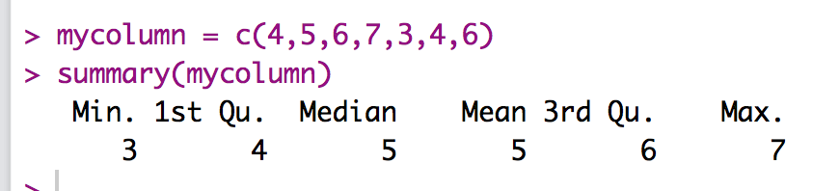
How-To R
How to calculate the mean:
Two ways:
summary(column name)
mean(column name, na.rm = T)

Slide 9
Central Tendency
Median: middle score when ordered from lowest to highest
No real symbol, but you can abbreviate mdn

Slide 10
Calculating the Median
Line up the scores in ascending order
Find the middle number
For an odd number of scores, just find the middle value.
For an even number of scores, divide number of scores by two.
Take the average of the scores around this position.

Slide 11
How-To R
You will get the median with the summary() function.
Or you can use:
median(column, na.rm = T)

Slide 12
Central Tendency
Mode: most common score
It’s the value:
With the largest frequency (or percent on a table).
The highest bar on a histogram depending on binwidth.
The highest point on a frequency polygon.
Note…sometimes there are multiple modes.

Slide 13
Calculating the Mode
Line up the scores in ascending order.
Find the most frequent score.
That’s the Mode!
Aka, book notes can be silly sometimes.

Slide 14
Mode + Distributions
We talked about this before but:
Unimodal = one hump distributions with one mode.
Bimodal = distributions with two modes.
Multimodal = distributions with three+ mode.
Remember we talked about traditionally how if there are 10 5s and 10 6s (that is technically two modes) that people consider that unimodal because they are so close together.

Slide 15
How-To R
Not as easy ☹
temp <- table(as.vector(column))
names(temp)[temp == max(temp)]

Slide 16
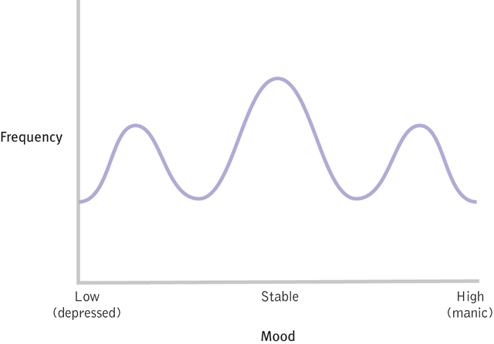
Why central tendency is not always the best answer:
Figure 4-4: Bipolar Disorder and the Modal Mood

Slide 17
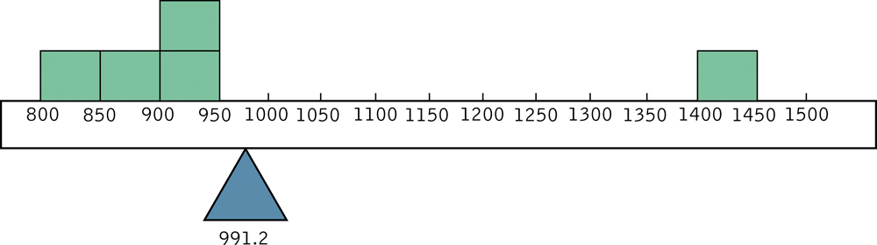
Outliers and the Mean
An early lesson in lying with statistics
Which central tendency is “best”: mean, median, or mode?
Depends!

Slide 18
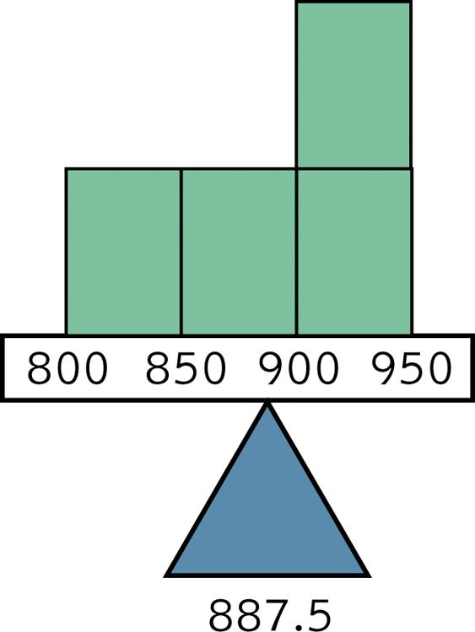
Figure 4-6:
The Mean without the Outlier

Slide 19
Let’s try it!
Add an outlier to our data.
outlier = c(mycolumn, #)
Rerun the mean, median, mode.
What happened?

Slide 20
Test with Outliers
So what happens if we delete our outliers?
Summary:
Mean is most affected by outliers (moved up or down, can be by a lot).
Best for symmetric distributions.
Median may change slightly one number up or down.
Best for skewed distributions or with outliers.
Generally the mode will not change. Uses:
One particular score dominates a distribution.
Distribution is bi or multi modal
Data are nominal.

Slide 21
Measures of Variability
Variability: a measure of how much spread there is in a distribution
Range
From the lowest to the highest score

Slide 22
Calculating the Range
Determine the highest score
Determine the lowest score
Subtract the lowest score from the highest score

Slide 23
How to Range
Use the summary() function to get the min and max and subtract.
Or do this:
max(column, na.rm = T) – min(column, na.rm = T)

Slide 24
Measures of Variability
Variance
Average squared deviation from the mean
How much, on average, do people vary from the middle?

Slide 25
Calculating the Variance
Subtract the mean from each score
Square every deviation from the mean
Sum the squared deviations
Divide the sum of squares by N
Super special notes right here about N versus N-1.

Slide 26
Measures of Variability
Standard deviation
(square root of variance)
Typical amount that each score deviates from the mean.
Most commonly used statistic with the mean.
Why use this when variance says the same thing?
Standardized – brings the numbers back to the original scaling (since they were squared before).
Still biased by scale.

Slide 27
Calculating the Standard Deviation
Typical amount the scores vary or deviate from the sample mean
This is the square root of variance

Slide 28
Quick Notes about Formulas
Samples usually use N – 1 as the denominator
UNBIASED
var(column name, na.rm = T)
sd(column name, na.rm = T)

Slide 29
Quick Notes about Formulas
Populations usually use N as the denominator
BIASED
Run this code as is:
pop.var <- function(x) var(x) * (length(x)-1) / length(x)
pop.sd <- function(x) sqrt(pop.var(x))

Slide 30
Quick Notes about Formulas
Populations usually use N as the denominator
BIASED
Run this code as is:
pop.var(column name)
pop.sd(column name)
We created our own functions!
So, you will have to run it every time you open R and want to use it.
Maybe start a “I need this” file with libraries, themes, and special functions?

Slide 31
Interquartile Range
Measure of the distance between the 1st and 3rd quartiles.
1st quartile: 25th percentile of a data set
The median marks the 50th percentile of a data set.
3rd quartile: marks the 75th percentile of a data set

Slide 32
Calculating the Interquartile Range
Subtract: 75th percentile – 25th percentile.
You can look at these numbers in the summary() function.
IQR(column name, na.rm = T)

